Slide 1

GPars:
Unsung Hero of Concurrency in Practice
http://playstationna.i.lithium.com/t5/image/serverpage/image-id/432281iDADEAFC04868CE5C?v=1.0

Slide 2

Yaroslav Yermilov Senior Software Engineer EPAM Systems https://yermilov.github.io/ https://twitter.com/yermilov17 https://www.facebook.com/yaroslav.yermilov https://ua.linkedin.com/pub/yaroslav-yermilov/58/682/506
work for EPAM Systems since 2011 in office - clustering, Big Data and automated testing out of office - Groovy
https://motherboard.vice.com/en_us/article/inside-rube-goldberg-machine-youtube-video-artist-joseph-herschers-bedroom-workshop

Slide 3
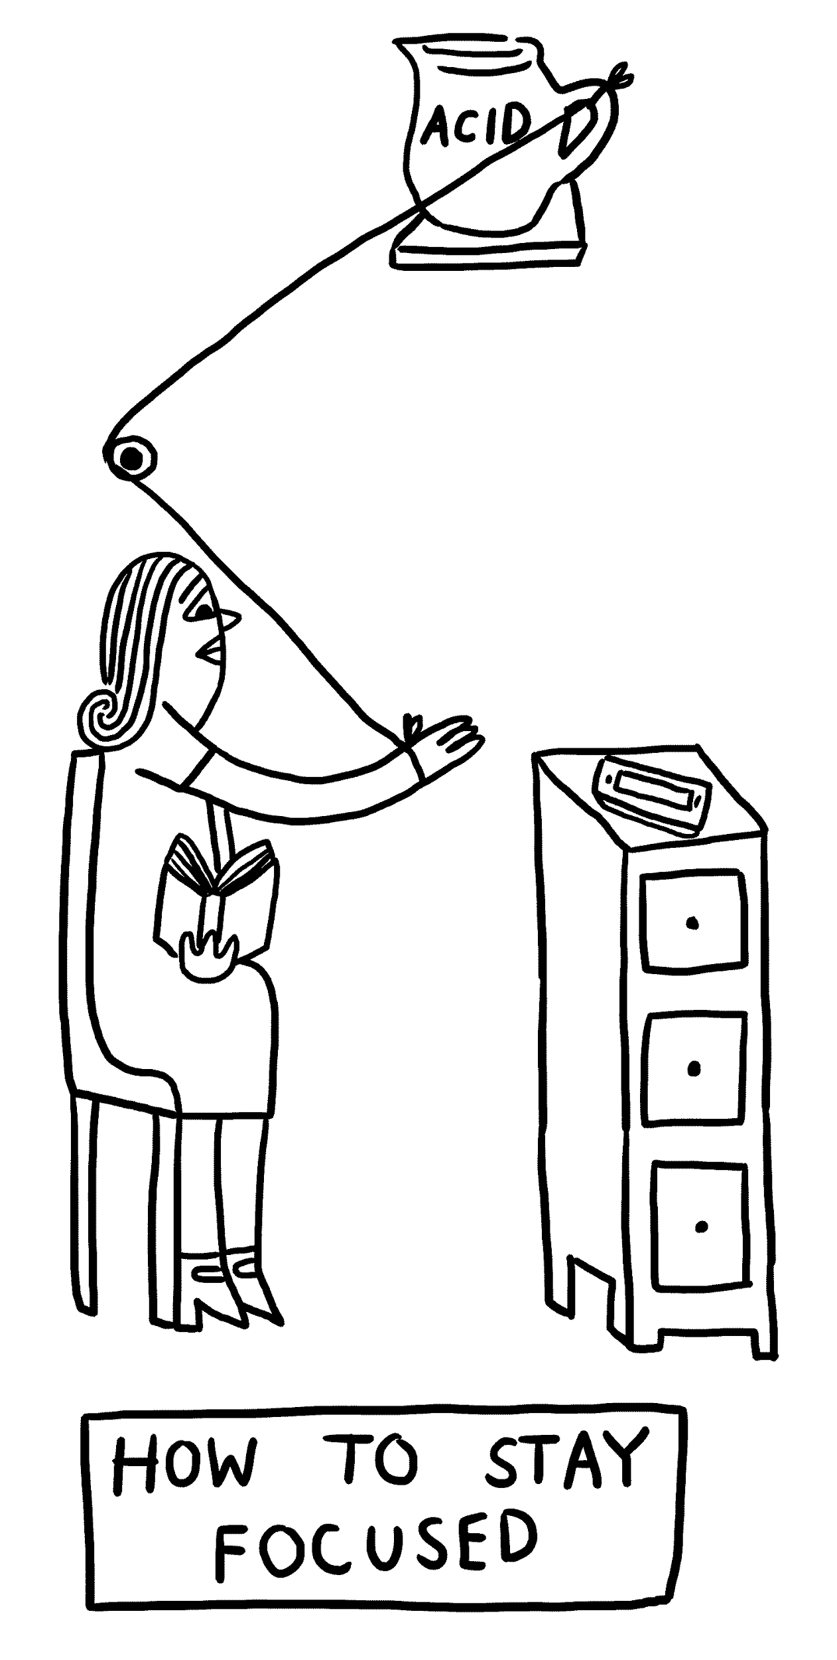
Focus for this talk
two guidelines for developing concurrent code
how Java handles concurrent/parallel development?
GPars place in this picture
how GPars handles concurrent/parallel development?
why and when use GPars?
why and when do not use GPars?
http://www.theverge.com/2015/4/22/8381963/rube-goldberg-machine-contest-history-ideas

Slide 4
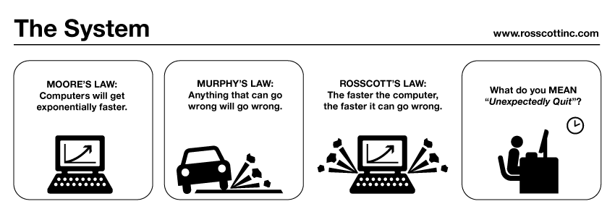
guideline #2 for developing concurrent code
public class Holder {
private int n;
public Holder(int n) { this.n = n; }
public void assertSanity() {
if (n != n) {
throw new AssertionError("Even it can go wrong!");
}
}
}
public class Initializer {
public Holder holder;
public void init() { holder = new Holder(42); }
}
public class Holder {
private int n;
public Holder(int n) { this.n = n; }
public void assertSanity() {
if (n != n) {
throw new AssertionError("Even it can go wrong!");
}
}
}
public class Initializer {
public Holder holder;
public void init() { holder = new Holder(42); }
}
MURPHY’S LAW:
Anything that can go wrong will go wrong.
http://www.systemcomic.com/2009/04/27/the-system-197

Slide 5
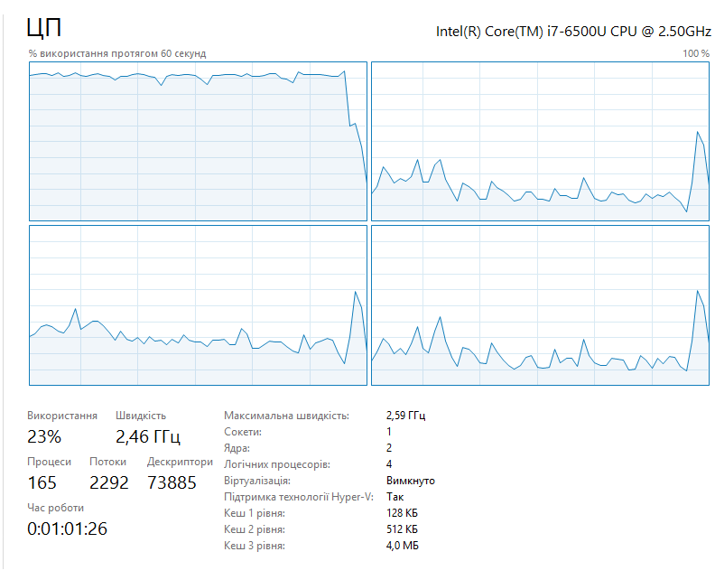
guideline #1 for developing concurrent code
MOORE’S LAW:
Computers will get exponentially faster.
http://www.systemcomic.com/2009/04/27/the-system-197

Slide 6
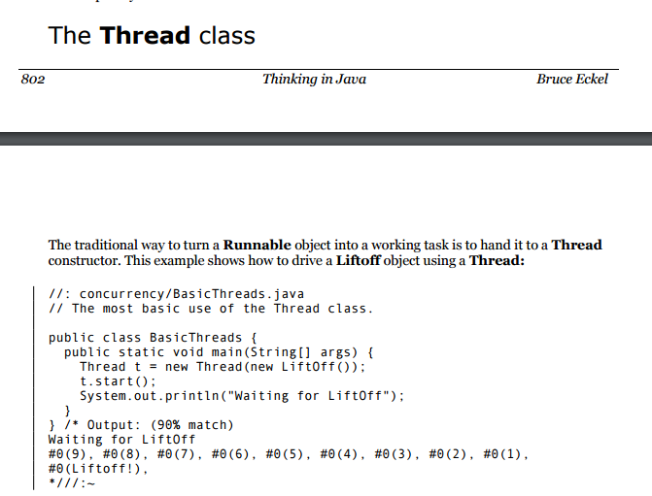

Slide 7
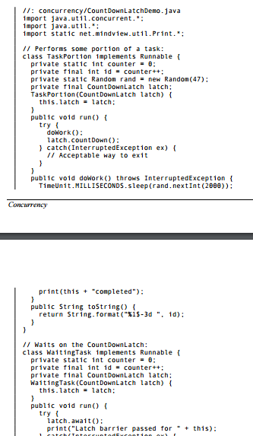
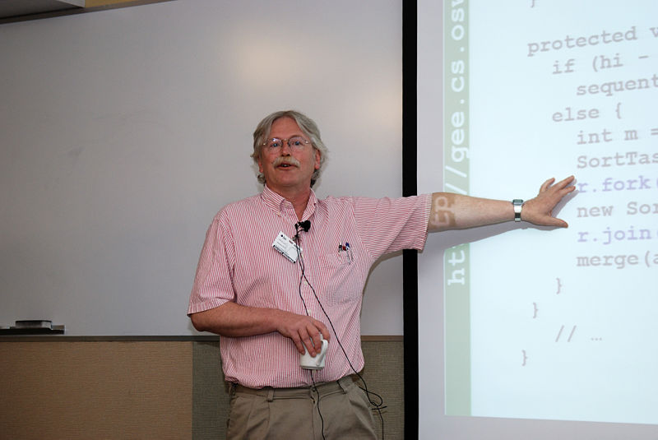
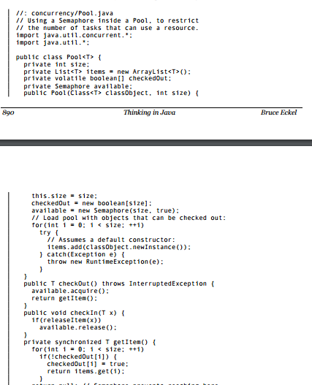
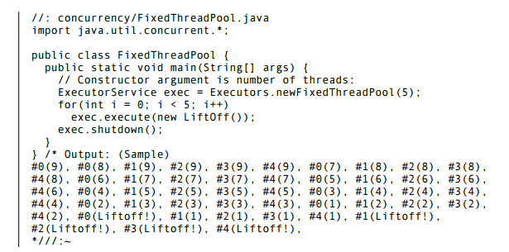
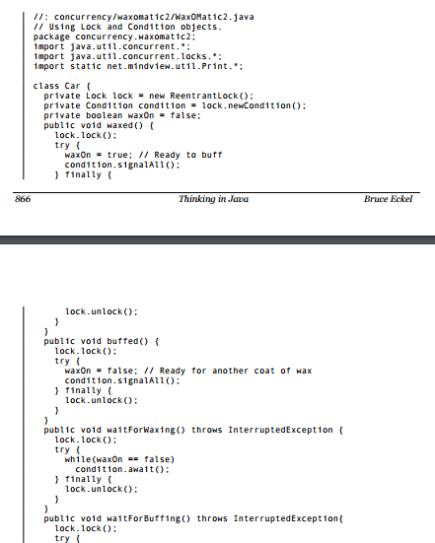
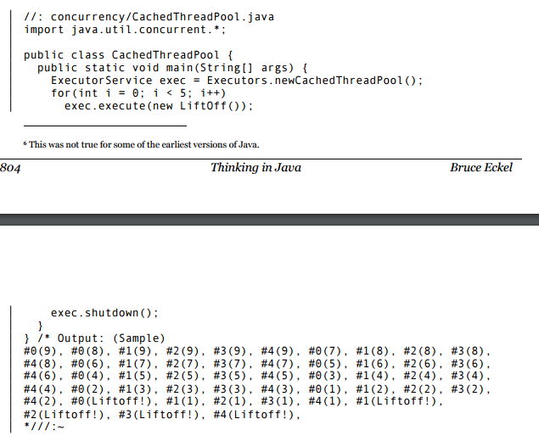
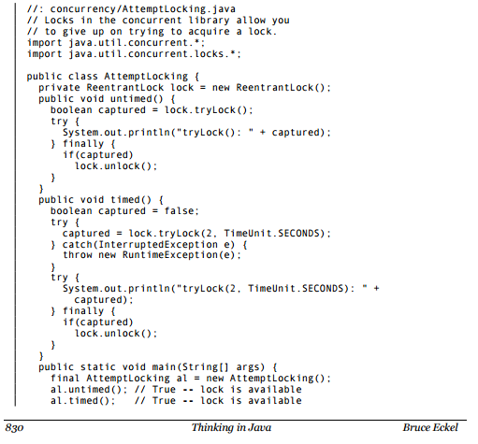
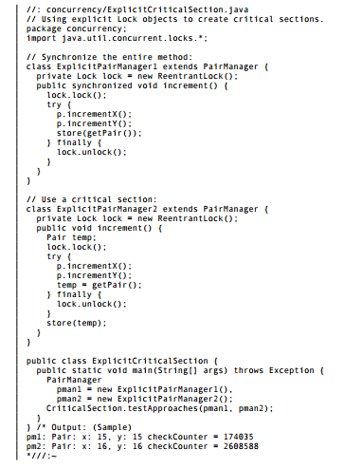
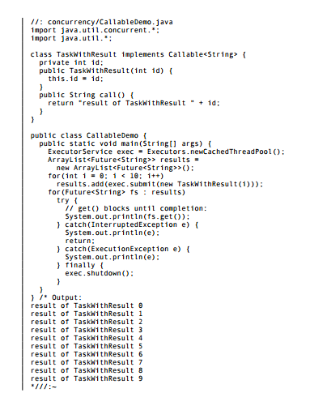
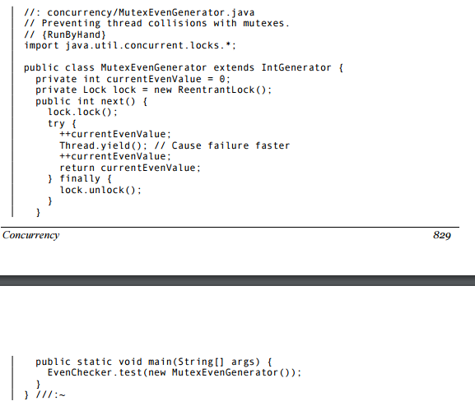
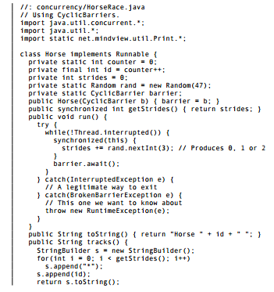
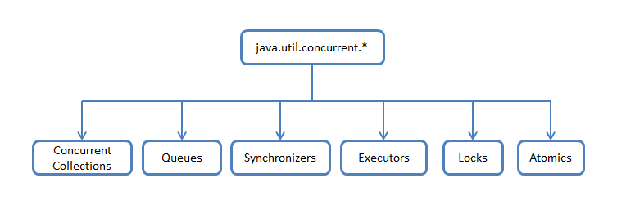
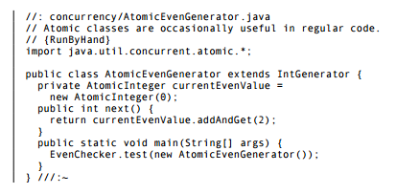
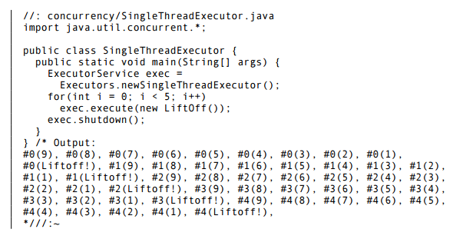

Slide 8
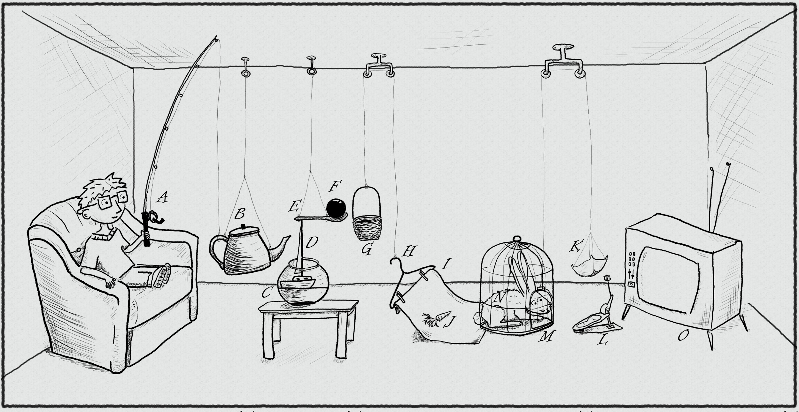
The traditional thread-based concurrency model built into Java doesn’t match well with the natural human sense for parallelism.
https://www.pinterest.com/pin/395190936024778319/

Slide 9

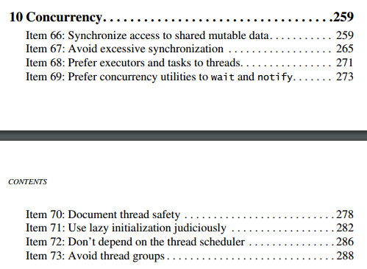

Slide 10
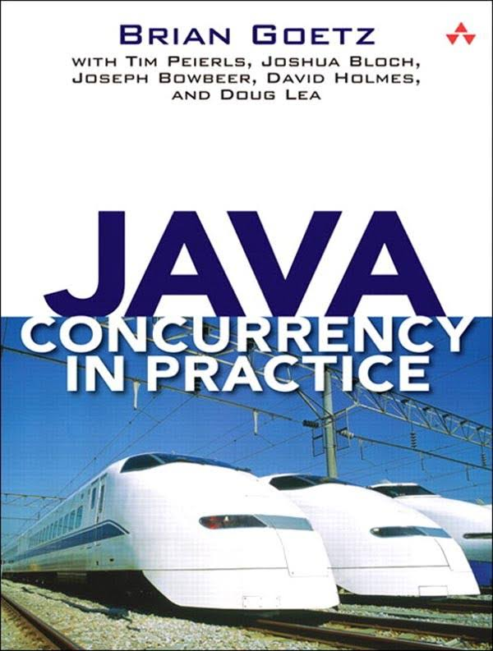
If multiple threads access the same mutable state variable without appropriate synchronization, your program is broken.
There are three ways to fix it:
Don’t share the state variable across threads
Make the state variable immutable
Use synchronization whenever accessing the state variable

Slide 11

public class MergeSortTask<T extends Comparable<T>> extends RecursiveTask<List<T>> {
@Override
protected List<T> compute() {
if (list.size() < 2) { return list; }
if (list.size() == 2) {
if (list.get(0).compareTo(list.get(1)) != 1) {
return list;
} else {
return asList(list.get(1), list.get(0));
}
}
MergeSortTask<T> leftTask = new MergeSortTask<>(list.subList(0, list.size() / 2));
MergeSortTask<T> rightTask = new MergeSortTask<>(list.subList(list.size() / 2, list.size()));
leftTask.fork(); rightTask.fork();
List<T> left = leftTask.join();
List<T> right = rightTask.join();
return merge(left, right);
}
http://blog.takipi.com/forkjoin-framework-vs-parallel-streams-vs-executorservice-the-ultimate-benchmark/

Slide 12

Optional<Status> mostPopularTweet = tweets.stream()
.parallel()
.filter(tweet -> tweet.getText().toLowerCase().contains(topic.toLowerCase()))
.filter(tweet -> !tweet.isRetweet())
.max(comparingInt(tweet -> tweet.getFavoriteCount() + tweet.getRetweetCount()));

Slide 13
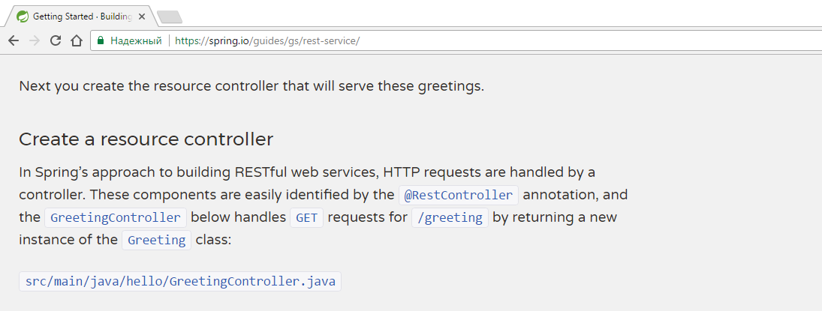
@RestController
public class GreetingController {
private static final String template = "Hello, %s!";
private final AtomicLong counter = new AtomicLong();
@RequestMapping("/greeting")
public Greeting greeting(@RequestParam(value="name", defaultValue="World") String name) {
return new Greeting(counter.incrementAndGet(), String.format(template, name));
}
}

Slide 14
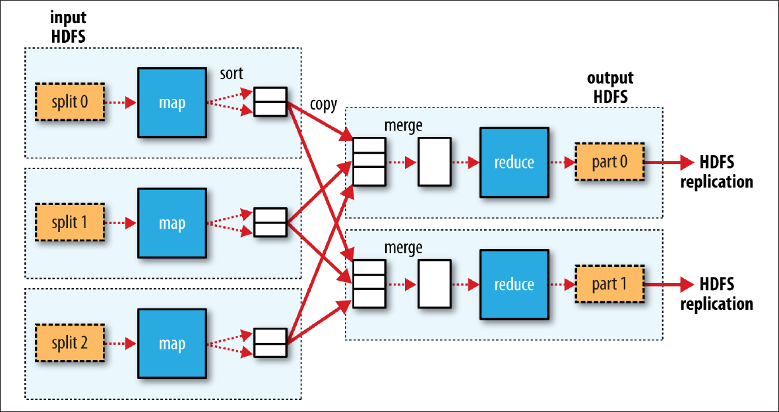

Slide 15
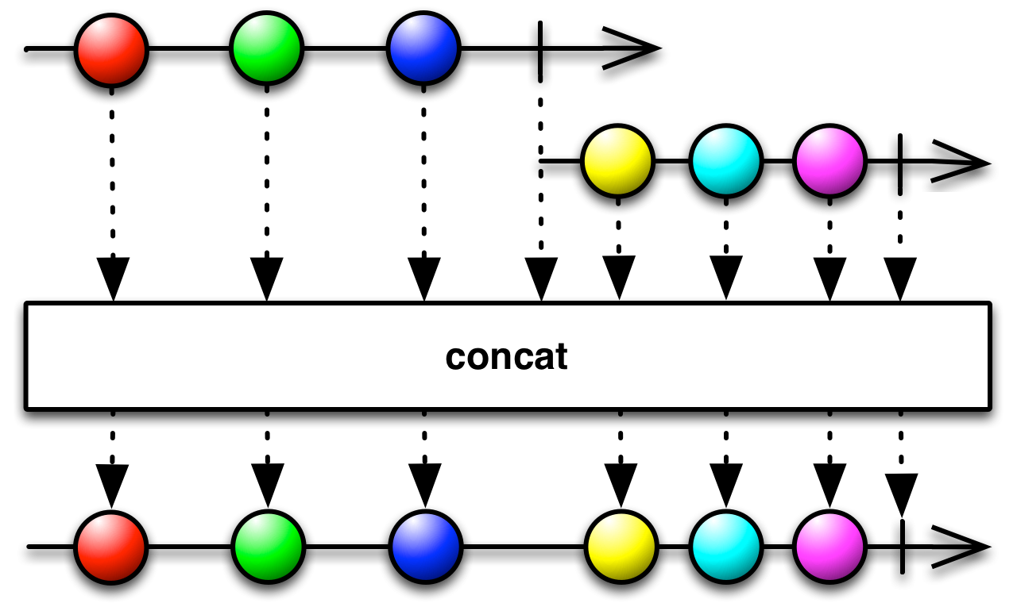
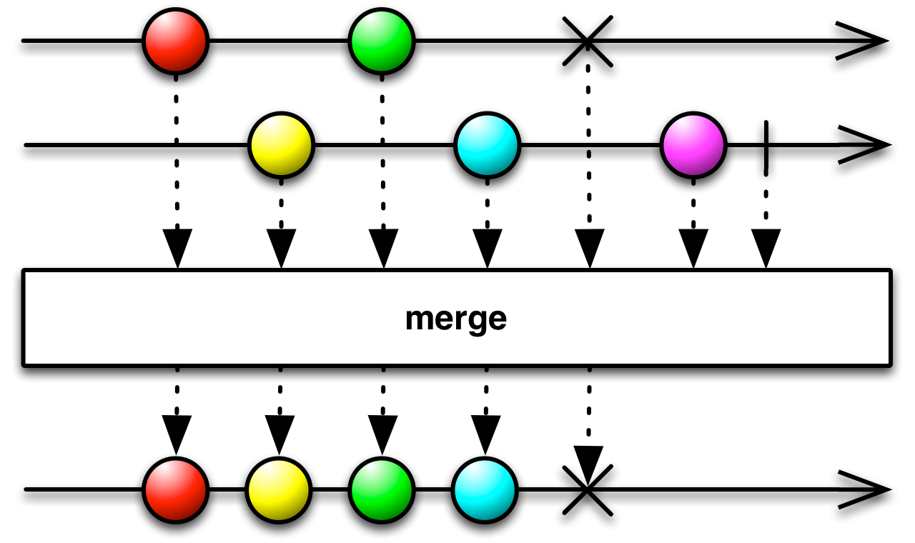
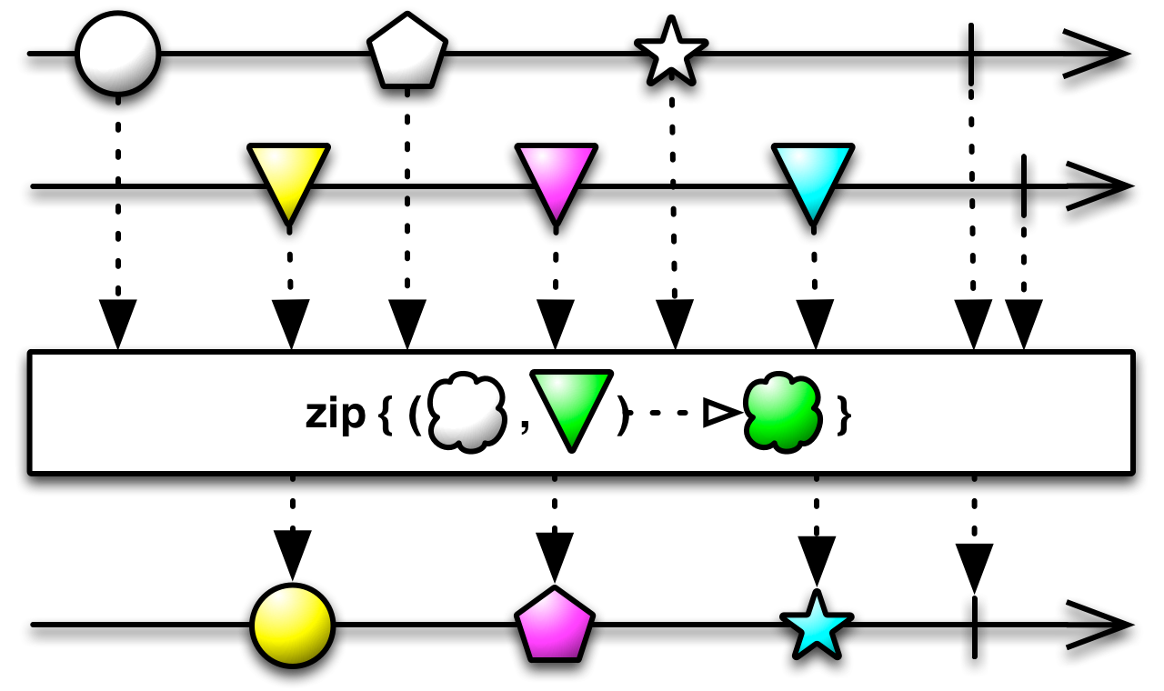
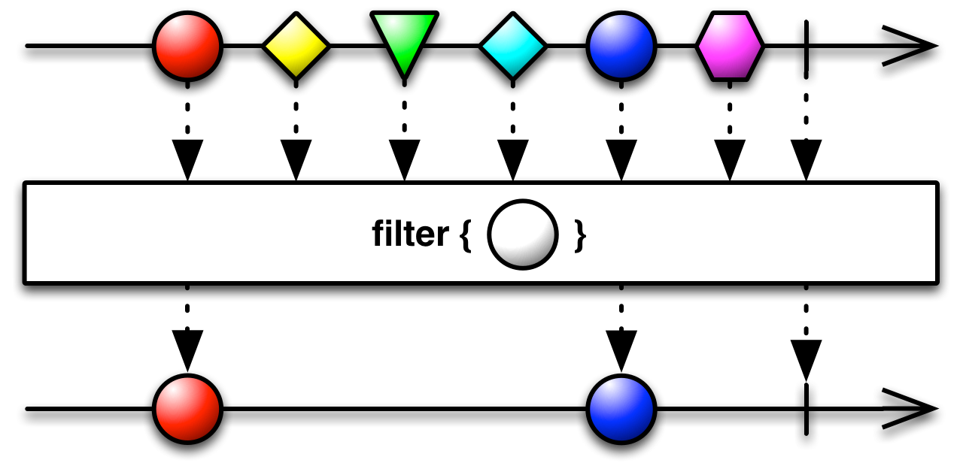
http://reactivex.io/RxJava/2.x/javadoc/io/reactivex/Flowable.html

Slide 16



Slide 17




GPars:
data parallelism map/reduce fork/join asynchronous closures agents actors dataflows
http://www.theverge.com/2015/4/22/8381963/rube-goldberg-machine-contest-history-ideas

Slide 18
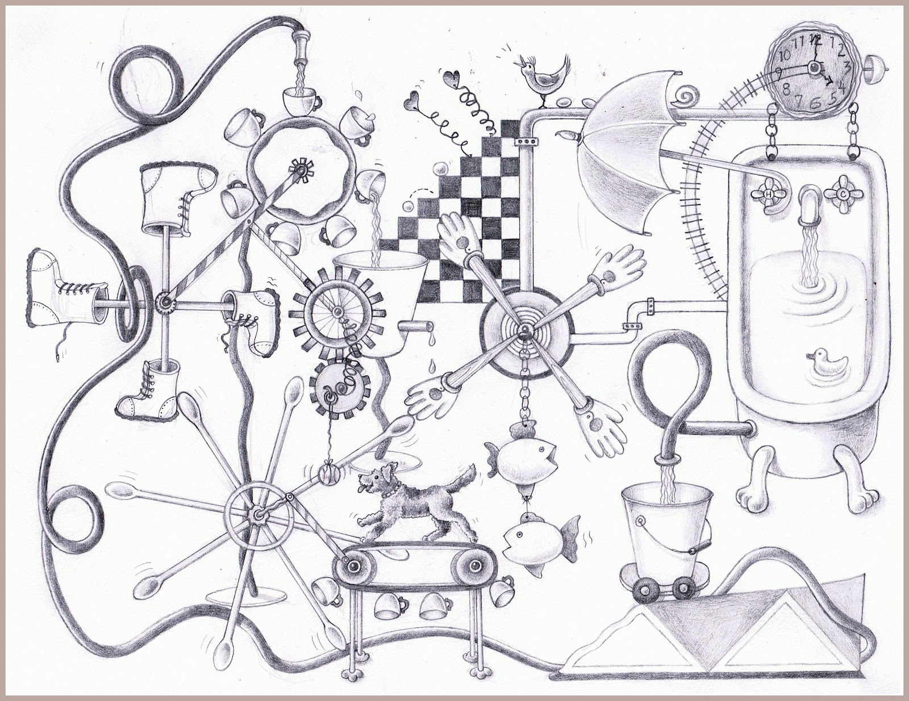
DEMO
https://www.pinterest.com/pin/527554543837493577/

Slide 19
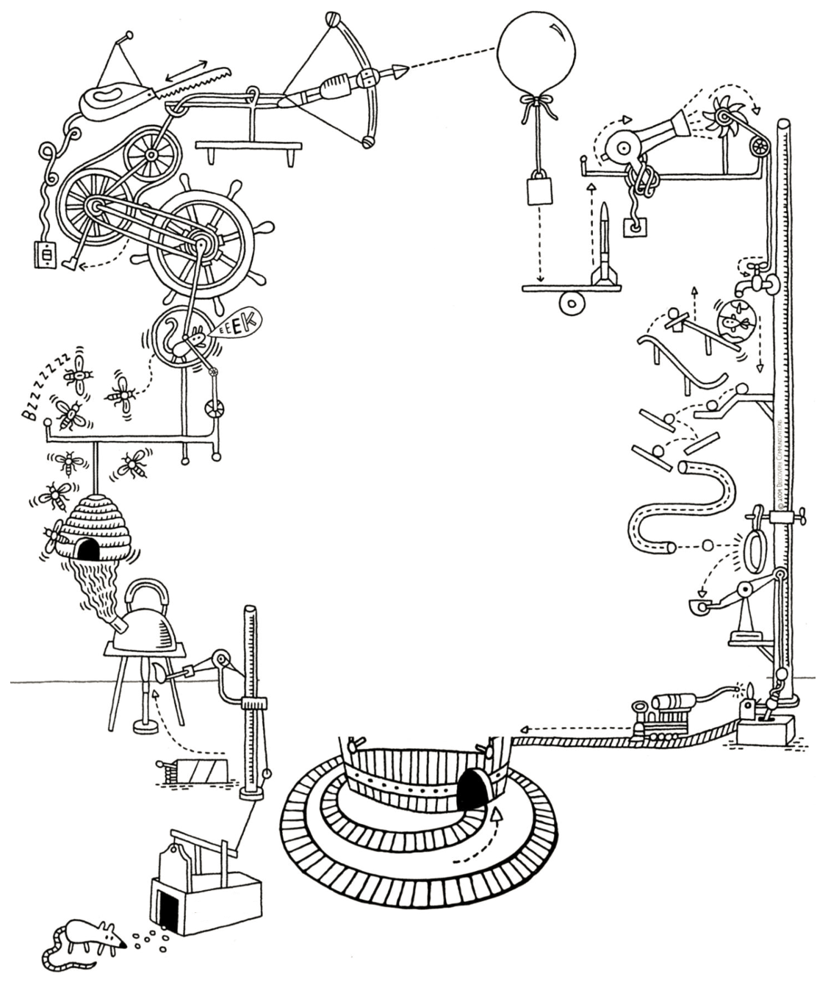
JAVA
OR
GROOVY?
http://forevercuriousmuseum.org/events/rube-goldberg-machine-summer-camp-july-28-29-30-2015/

Slide 20
public final class ImmutableJavaPerson {
private final String name;
private final Collection<String> tweets;
public ImmutableJavaPerson(String name, Collection<String> tweets) {
this.name = name;
this.tweets = new ArrayList<>(tweets);
}
public String getName() {
return name;
}
public Collection<String> getTweets() {
return unmodifiableCollection(tweets);
}
@Override
public boolean equals(Object o) {
if (this == o) return true;
if (o == null || getClass() != o.getClass()) return false;
ImmutableJavaPerson that = (ImmutableJavaPerson) o;
if (name != null ? !name.equals(that.name) : that.name != null) return false;
return tweets != null ? tweets.equals(that.tweets) : that.tweets == null;
}
@Override
public int hashCode() {
int result = name != null ? name.hashCode() : 0;
result = 31 * result + (tweets != null ? tweets.hashCode() : 0);
return result;
}
}

Slide 21
@Override
public boolean equals(Object o) {
if (this == o) return true;
if (o == null || getClass() != o.getClass()) return false;
ImmutableJavaPerson that = (ImmutableJavaPerson) o;
if (name != null ? !name.equals(that.name) : that.name != null) return false;
return tweets != null ? tweets.equals(that.tweets) : that.tweets == null;
}
@Override
public int hashCode() {
int result = name != null ? name.hashCode() : 0;
result = 31 * result + (tweets != null ? tweets.hashCode() : 0);
return result;
}
}

Slide 22

@Immutable class ImmutableGroovyPerson {
String name
Collection<String> tweets
}

Slide 23
def thread1 = Thread.start {
println "Hello from ${Thread.currentThread().name}"
}
def thread2 = Thread.startDaemon {
println "Hello from ${Thread.currentThread().name}"
}
[ thread1, thread2 ]*.join()

Slide 24
def process = (['git', 'status']).execute([], new File('.'))
def processOutput = new StringWriter()
process.consumeProcessOutput processOutput, processOutput
process.waitFor()
println processOutput.toString().trim()

Slide 25
class SynchronizedCounter {
int atomicCounter
int counter
@Synchronized
int incrementAndGet() {
atomicCounter = atomicCounter + 1
return atomicCounter
}
@WithReadLock
int value() {
counter
}
@WithWriteLock
void increment() {
counter = counter + 1
}
}

Slide 26
def findMostPopularTweet = { Map params ->
String topic = params.about
Collection tweets = params.from
tweets.findAll({ Status tweet ->
tweet.text.toLowerCase().contains(topic.toLowerCase())
}).findAll({ Status tweet ->
!tweet.retweet
}).collect ({ Status tweet ->
[
user: tweet.user.screenName,
text: tweet.text,
favourited: tweet.favoriteCount,
retweeted: tweet.retweetCount
]
}).max({
it.favourited + it.retweeted
})
}
def result = findMostPopularTweet about: 'gpars', from: jeeconfTweets

Slide 27

def findMostPopularTweet = { Map params ->
String topic = params.about
Collection tweets = params.from
tweets.findAll({ Status tweet ->
tweet.text.toLowerCase().contains(topic.toLowerCase())
}).findAll({ Status tweet ->
!tweet.retweet
}).collect ({ Status tweet ->
[
user: tweet.user.screenName,
text: tweet.text,
favourited: tweet.favoriteCount,
retweeted: tweet.retweetCount
]
}).max({
it.favourited + it.retweeted
})
}
ParallelEnhancer.enhanceInstance(jeeconfTweets)
jeeconfTweets.makeConcurrent()
def result = findMostPopularTweet about: 'gpars', from: jeeconfTweets

Slide 28
Optional<Status> mostPopularTweet = tweets.stream()
.parallel()
.filter(tweet -> tweet.getText().toLowerCase().contains(topic.toLowerCase()))
.filter(tweet -> !tweet.isRetweet())
.max(comparingInt(tweet -> tweet.getFavoriteCount() + tweet.getRetweetCount()));

Slide 29
def findMostPopularTweet = { Map params ->
String topic = params.about
Collection tweets = params.from
withPool {
tweets.parallel.filter({ Status tweet ->
tweet.text.toLowerCase().contains(topic.toLowerCase())
}).filter({ Status tweet ->
!tweet.retweet
}).map({ Status tweet ->
[
user: tweet.user.screenName,
text: tweet.text,
favourited: tweet.favoriteCount,
retweeted: tweet.retweetCount
]
}).max({
it.favourited + it.retweeted
})
}
}
def result = findMostPopularTweet about: 'gpars', from: jeeconfTweets

Slide 30
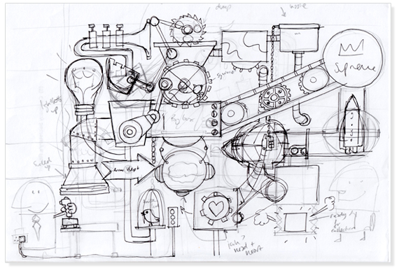
WITH
POOL
https://discoveryartjoy.wordpress.com/page/2/

Slide 31
withPool {
Closure fetchLatestTweets = twitter.&fetchLatestTweets.asyncFun()
Closure determineTopic = topics.&determineTopic.asyncFun()
Closure aggregateTopics = topics.&aggregateTopics.asyncFun()
Closure fetchNewsAbout = news.&fetchNewsAbout.asyncFun()
Closure filterMostImportant = news.&filterMostImportant.asyncFun()
Promise topics = determineTopic(fetchLatestTweets)
Promise aggregatedTopics = topics.get().inject({ t1, t2 -> aggregateTopics(t1, t2) })
aggregatedTopics.then {
fetchNewsAbout(it)
}.then {
filterMostImportant(it)
}.then {
println it
}.join()
}

Slide 32
withPool {
Closure fetchLatestTweets = twitter.&fetchLatestTweets.asyncFun()
Closure determineTopic = topics.&determineTopic.asyncFun()
Closure aggregateTopics = topics.&aggregateTopics.gmemoize()
Closure fetchNewsAbout = news.&fetchNewsAbout.asyncFun()
Closure filterMostImportant = news.&filterMostImportant.asyncFun()
Promise topics = determineTopic(fetchLatestTweets)
Promise aggregatedTopics = topics.get().inject({ t1, t2 -> aggregateTopics(t1, t2) })
aggregatedTopics.then {
fetchNewsAbout(it)
}.then {
filterMostImportant(it)
}.then {
println it
}.join()
}

Slide 33

AGENTS
http://www.keywordsuggests.com/DT5zG9YMrnEK707aqUa2IhkNs5vUwu3mV6WrrLHR0soHddyR42EFvbEkYg9kaqswD%7CyremGnEFLO%7CzJXdp0SMQ/

Slide 34
def stringGuard = new Agent<String>()
28.times {
Thread.start {
stringGuard { updateValue(it + '|' + Thread.currentThread().name) }
}
}
println stringGuard.val
def listGuard = new Agent<List<String>>()
43.times {
Thread.start {
listGuard { it.add(Thread.currentThread().name) }
}
}
listGuard.valAsync {
println it
}

Slide 35
final Agent<String> stringGuard = new Agent<>();
stringGuard.send(new MessagingRunnable<String>() {
@Override
protected void doRun(String value) {
stringGuard.updateValue(value + '|' + Thread.currentThread().getName());
}
});
System.out.println(stringGuard.getVal());
final Agent<List<String>> listGuard = new Agent<>();
listGuard.send(new ArrayList<>());
listGuard.send(new MessagingRunnable<List<String>>() {
@Override
protected void doRun(List<String> value) {
value.add(Thread.currentThread().getName());
}
});
listGuard.valAsync(new MessagingRunnable<List<String>>() {
@Override
protected void doRun(List<String> value) {
System.out.println(value);
}
});

Slide 36
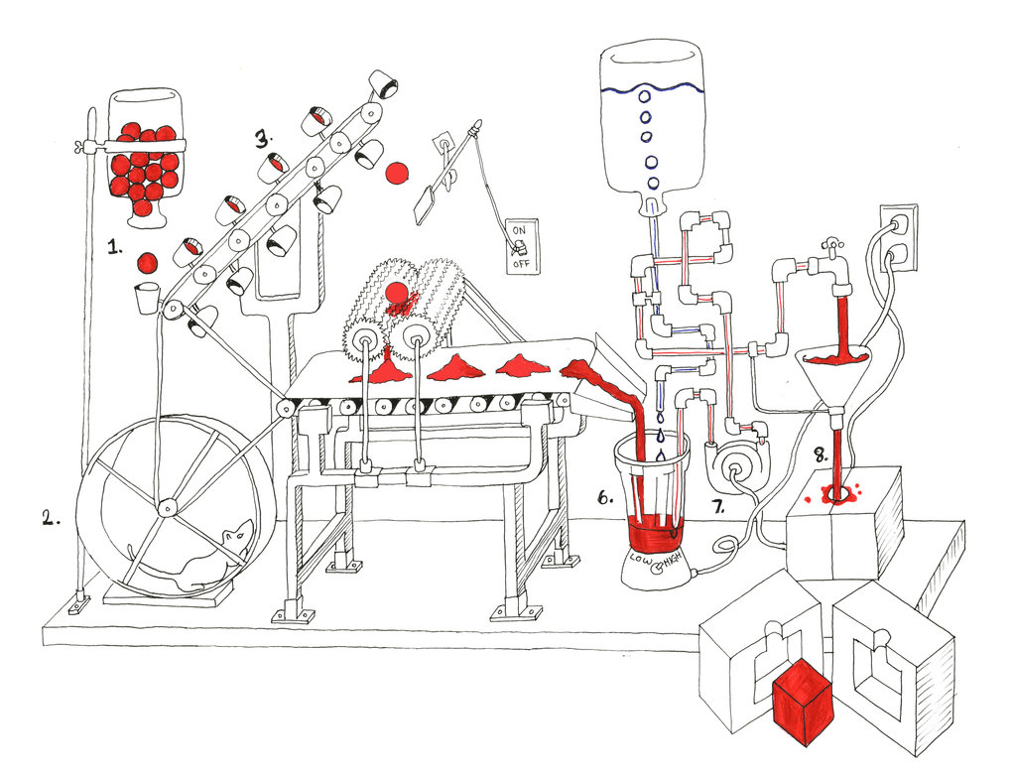
ACTORS
http://tommyboy5000.deviantart.com/art/Rube-Goldberg-machine-485199926

Slide 37
def main = actor {
loop {
fetchLatestNews.send()
react { latestNews ->
extractText latestNews
react { text -> save text }
}
}
}
def fetchLatestNews = reactor {
news.fetchLatest()
}
def extractText = messageHandler {
when { Tweet tweet -> reply tweet.status }
when { FacebookPost facebookPost -> reply facebookPost.post }
when { BlogArticle blogArticle -> reply blogArticle.text }
}
def save = reactor { text ->
println text
}

Slide 38
final Closure handler = new ReactorMessagingRunnable() {
@Override
protected Object doRun(Object argument) {
return news.fetchLatest();
}
};
final Actor actor = new ReactiveActor(handler);
actor.start();

Slide 39
public class MessageHandler extends DynamicDispatchActor {
public void onMessage(final Tweet tweet) {
replyIfExists(tweet.getStatus());
}
public void onMessage(final FacebookPost facebookPost) {
replyIfExists(facebookPost.getPost());
}
public void onMessage(final BlogArticle blogArticle) {
replyIfExists(blogArticle.getText());
}
}

Slide 40
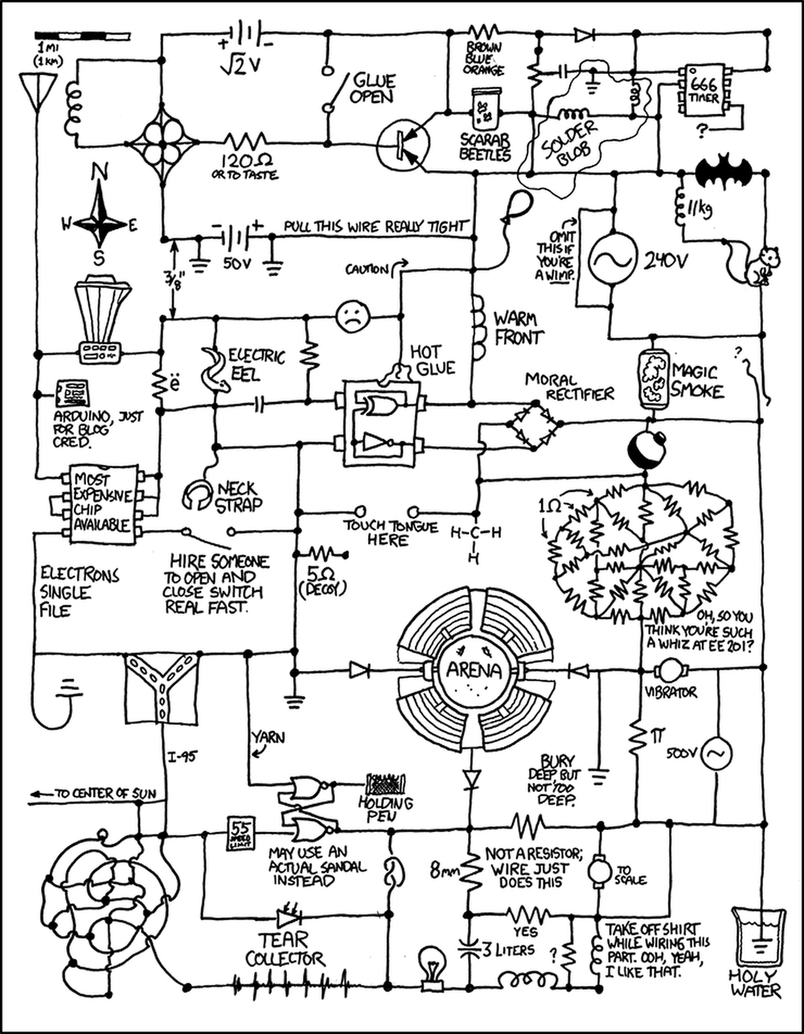
DATAFLOWS
http://www.projectroomseattle.org/programs-content/2014/6/preparing-for-the-failure-variety-show-the-rube-goldberg-confessionals

Slide 41
final dataflow = new Dataflows()
println dataflow.numberOfInteractions
task {
dataflow.numberOfInteractions = dataflow.retweets + dataflow.facebookLikes
}
task {
dataflow.retweets = twitter.numberOfRetweets(article)
}
task {
dataflow.facebookLikes = facebook.numberofLikes(article)
}

Slide 42
final DataflowVariable<Integer> numberOfInteractions = new DataflowVariable<>();
final DataflowVariable<Integer> retweets = new DataflowVariable<>();
final DataflowVariable<Integer> facebookLikes = new DataflowVariable<>();
System.out.println(numberOfInteractions.getVal());
task((Runnable) () -> {
try {
numberOfInteractions.bind(retweets.getVal() + facebookLikes.getVal());
} catch (InterruptedException e) {
throw new RuntimeException(e);
}
});
task(() -> retweets.bind(twitter.numberOfRetweets(article)));
task(() -> facebookLikes.bind(facebook.numberofLikes(article)));

Slide 43
def retweets = new DataflowQueue()
def facebookLikes = new DataflowQueue()
def numberOfInteractions = new DataflowQueue()
operator(
inputs: [ retweets, facebookLikes ],
outputs: [ numberOfInteractions ],
{ retweetsCount, facebookLikesCount ->
numberOfInteractions << retweetsCount + facebookLikesCount
}
)
task {
ALL_ARTICLES.each { article -> retweets << twitter.numberOfRetweets(article) }
}
task {
ALL_ARTICLES.each { article -> facebookLikes << facebook.numberofLikes(article) }
}

Slide 44
final DataflowQueue retweets = new DataflowQueue();
final DataflowQueue facebookLikes = new DataflowQueue();
final DataflowQueue numberOfInteractions = new DataflowQueue();
operator(
asList(retweets, facebookLikes),
asList(numberOfInteractions),
new DataflowMessagingRunnable(2) {
@Override
protected void doRun(Object... arguments) {
getOwningProcessor().bindOutput((Integer)arguments[0] + (Integer)arguments[1]);
}
});
task(() -> ALL_ARTICLES.forEach(a -> retweets.bind(twitter.numberOfRetweets(a))));
task(() -> ALL_ARTICLES.forEach(a -> facebookLikes.bind(facebook.numberOfLikes(a))));

Slide 45

WHY USE GPARS?
WHEN DO USE GPARS? - PARALLEL STREAMS
TO IMPROVE PERFORMANCE OF SEQUENTIAL CODE
SIMPLIFY DEVELOPMENT OF CONCURRENT/PARALLEL CODE
USE CLOSE-TO-DOMAIN ABSTRACTIONS
REDUCE NUMBER OF ERRORS
INTEGRATE DIFFERENT ABSTRACTIONS EASILY
http://sweetlygrotesque.blogspot.com/2012/01/concept-sketches-goldberg-machine.html

Slide 46
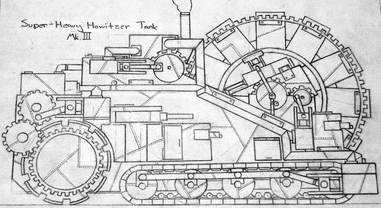
FURTHER DIVE
Examples from slides
Groovy and Concurrency with GPars by Paul King Gpars: Concurrency in Java & Groovy by Ken Kousen
Official site Sources Slack channel
The GPars User Guide 'Concurrent Groovy with GPars' chapter from 'Groovy in Action' book
https://s-media-cache-ak0.pinimg.com/originals/94/7b/55/947b558df61fd46caa6d041c1a21bb40.jpg

Slide 47
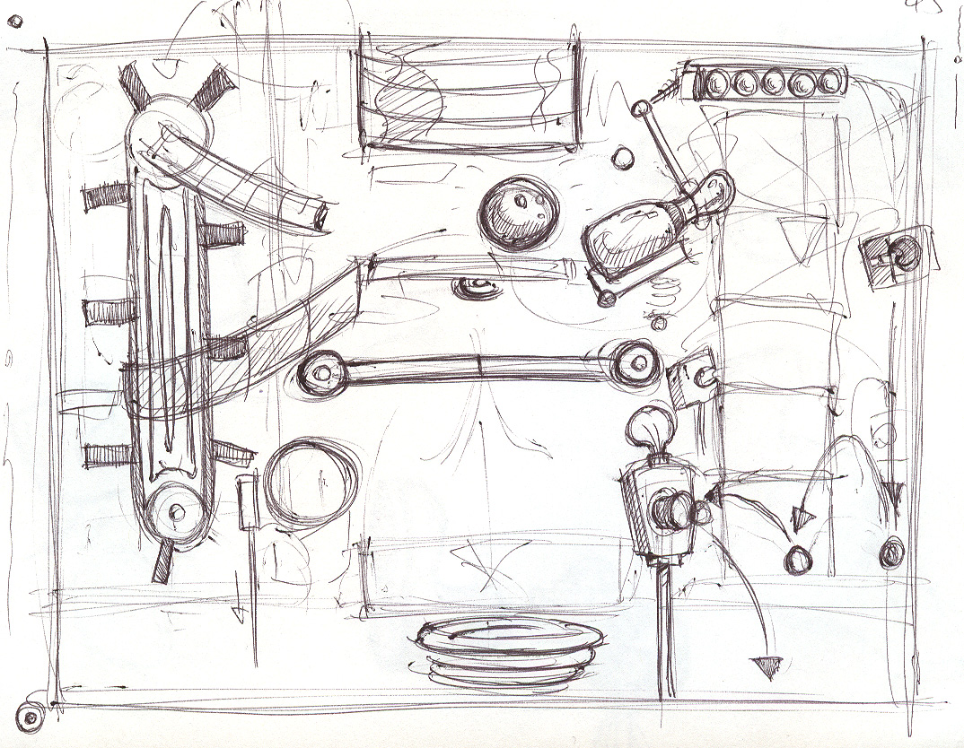
Q/A
THANK YOU!
http://sweetlygrotesque.blogspot.com/2012/01/concept-sketches-goldberg-machine.html

